Slide 1
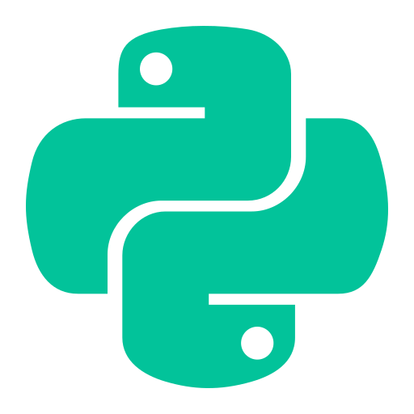
DecodeLabs
To-Do List Manager
Project 1 — CLI Python Application
Developer: Laiba Maqbool
Role: Python Developer (Intern)
Status: ✔ Complete
Greater Lucknow, India

Slide 2





Project Overview & Objectives
Build a CLI To-Do List Manager that stores, retrieves, and modifies tasks in a Python list and persists data using JSON. Core skills: lists, dictionaries, file I/O, JSON serialization, CLI I/O, and state management.
Role
Organization
Status
Junior Python Developer (Intern)
DecodeLabs, Greater Lucknow, India
Completed ✔ — Logic Phase
Key Skills Exercised
Python Lists
Dictionaries
File I/O
JSON
CLI
DecodeLabs | Project 1

Slide 3



Task Requirements
The program must support: adding tasks, listing with status, marking complete, deleting by ID, and persisting data across runs using JSON with graceful error handling.
Add Task
View Tasks
Accept a task description and append a task dictionary to the list.
Print numbered list using enumerate(), show status icons for done/undone.
Mark & Delete
Persistence
Toggle completion and remove tasks by ID — update JSON on every change.
Serialize the list of dicts to disk with json.dump() and load on startup.
DecodeLabs | Project 1

Slide 4
System Architecture & Flow
Single-process CLI: Load → Mutate → Save. Each user action triggers a json.dump to persist changes.
1
2
3
4
Startup
Show Menu
User Action
Save
Load tasks.json
(or start with [])
▶
add / view / done
delete / quit
▶
Mutate in-memory
task list
▶
json.dump()
to tasks.json
Load / Save
Operations
CLI Loop
json.load / json.dump with try/except for safe file handling.
add_task(desc), list_tasks(), mark_done(id), delete_task(id)
Menu loop: add, view, done, delete, quit — simple and robust.
DecodeLabs | Project 1

Slide 5
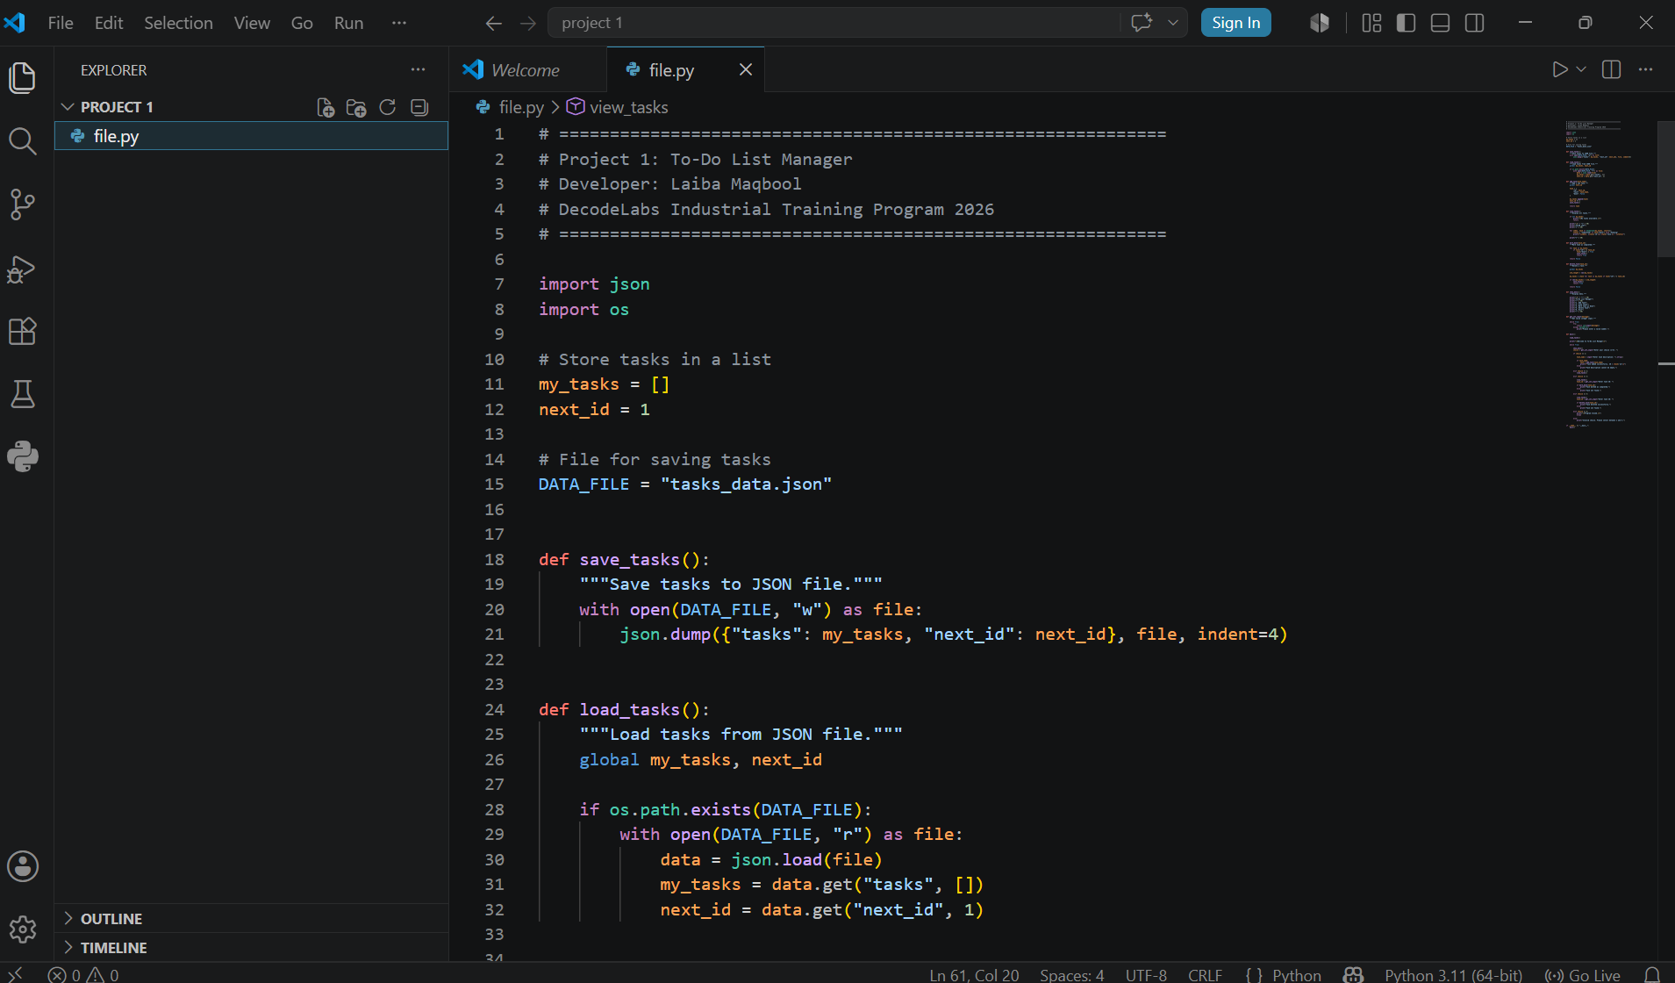

Slide 6
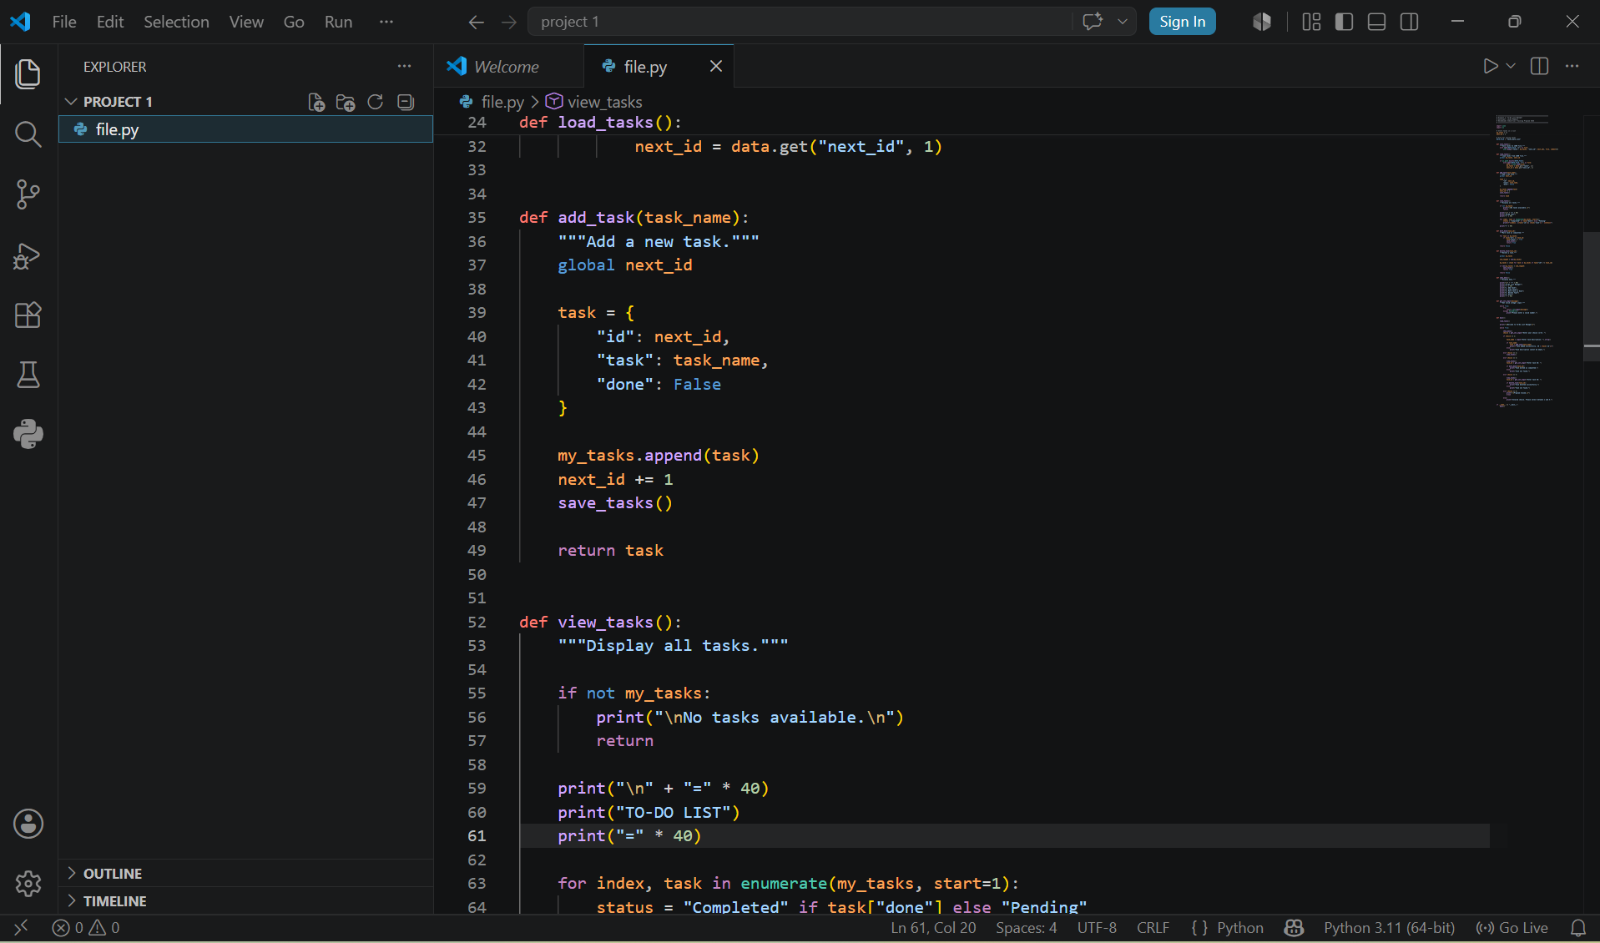

Slide 7
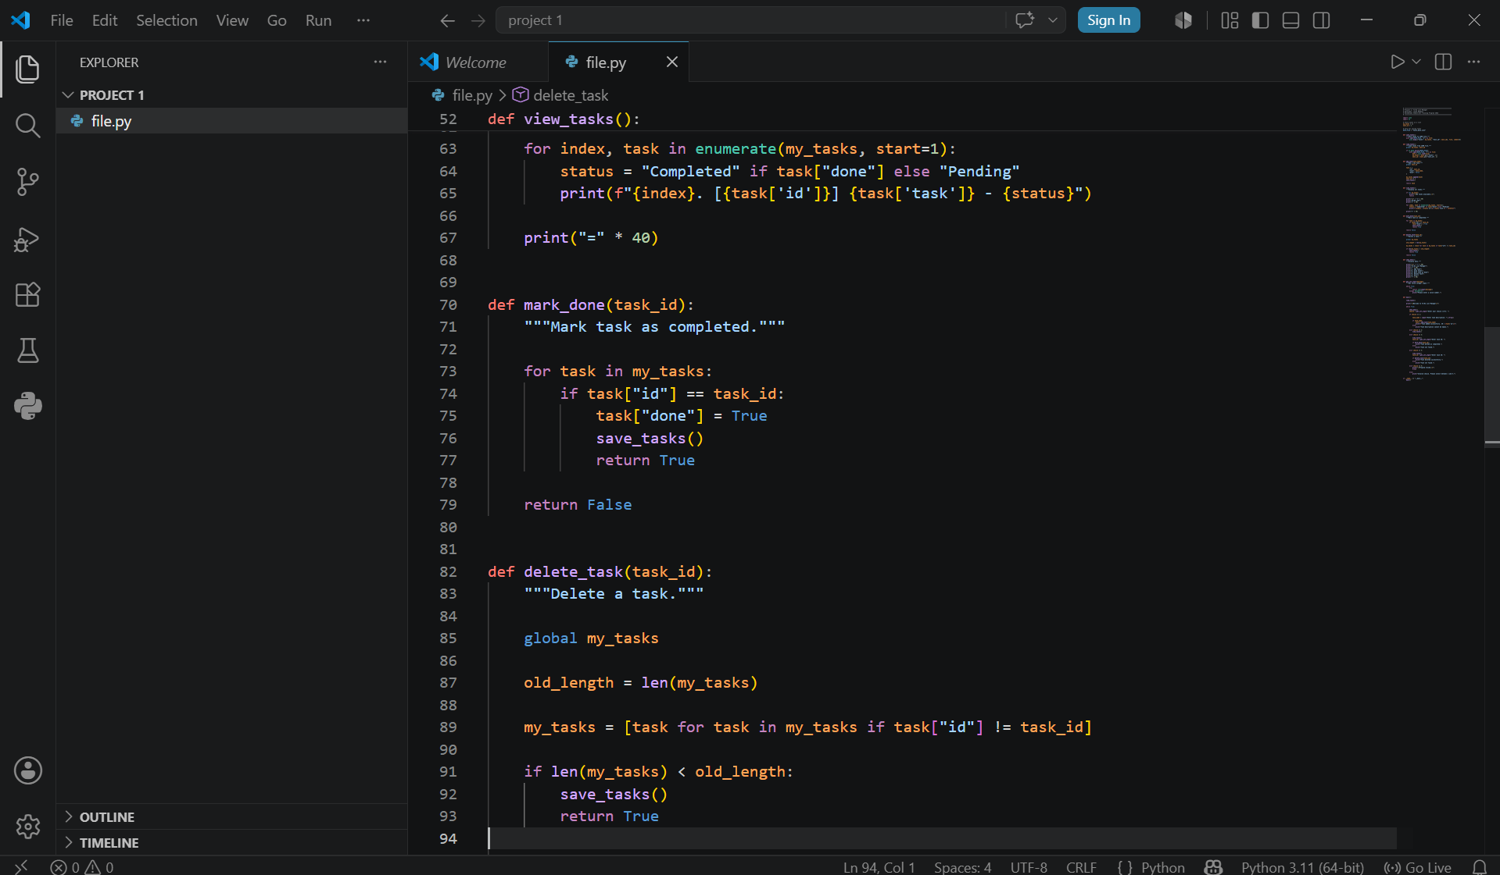

Slide 8
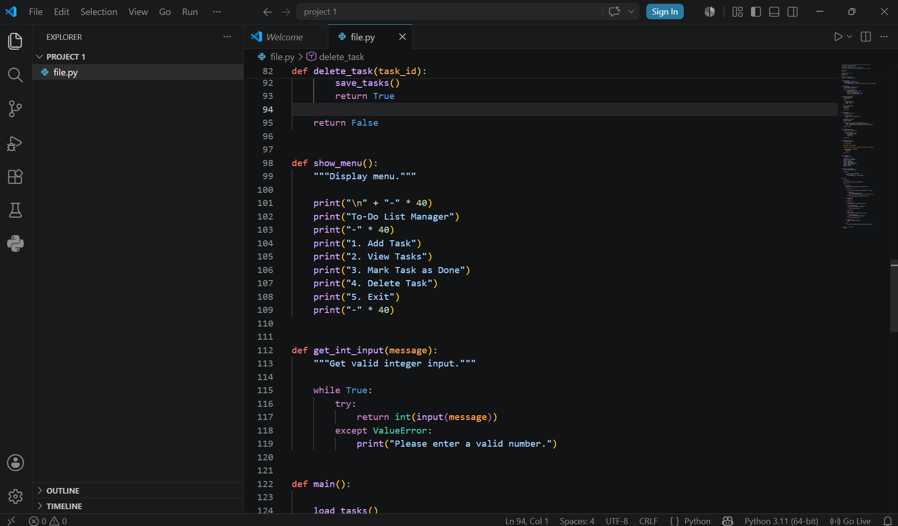

Slide 9
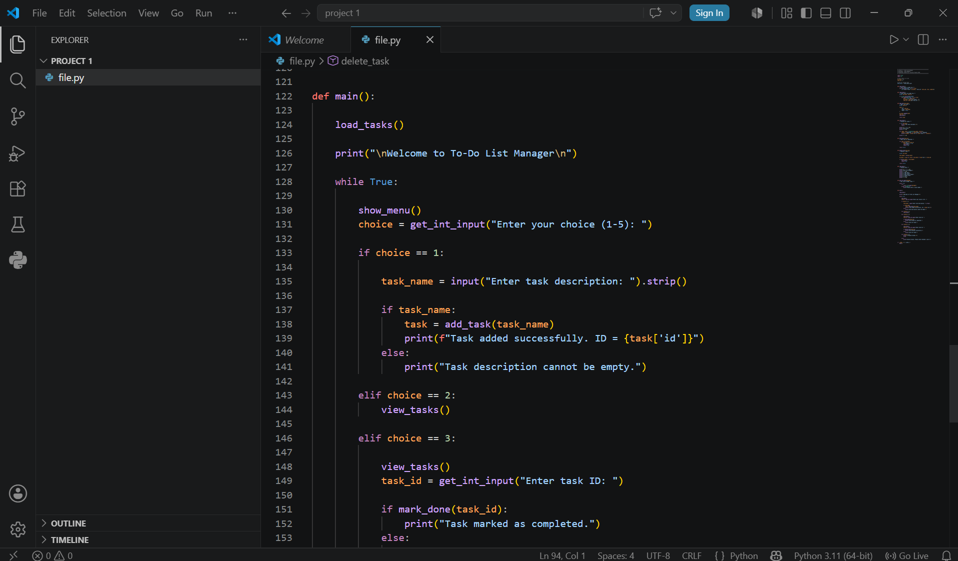

Slide 10
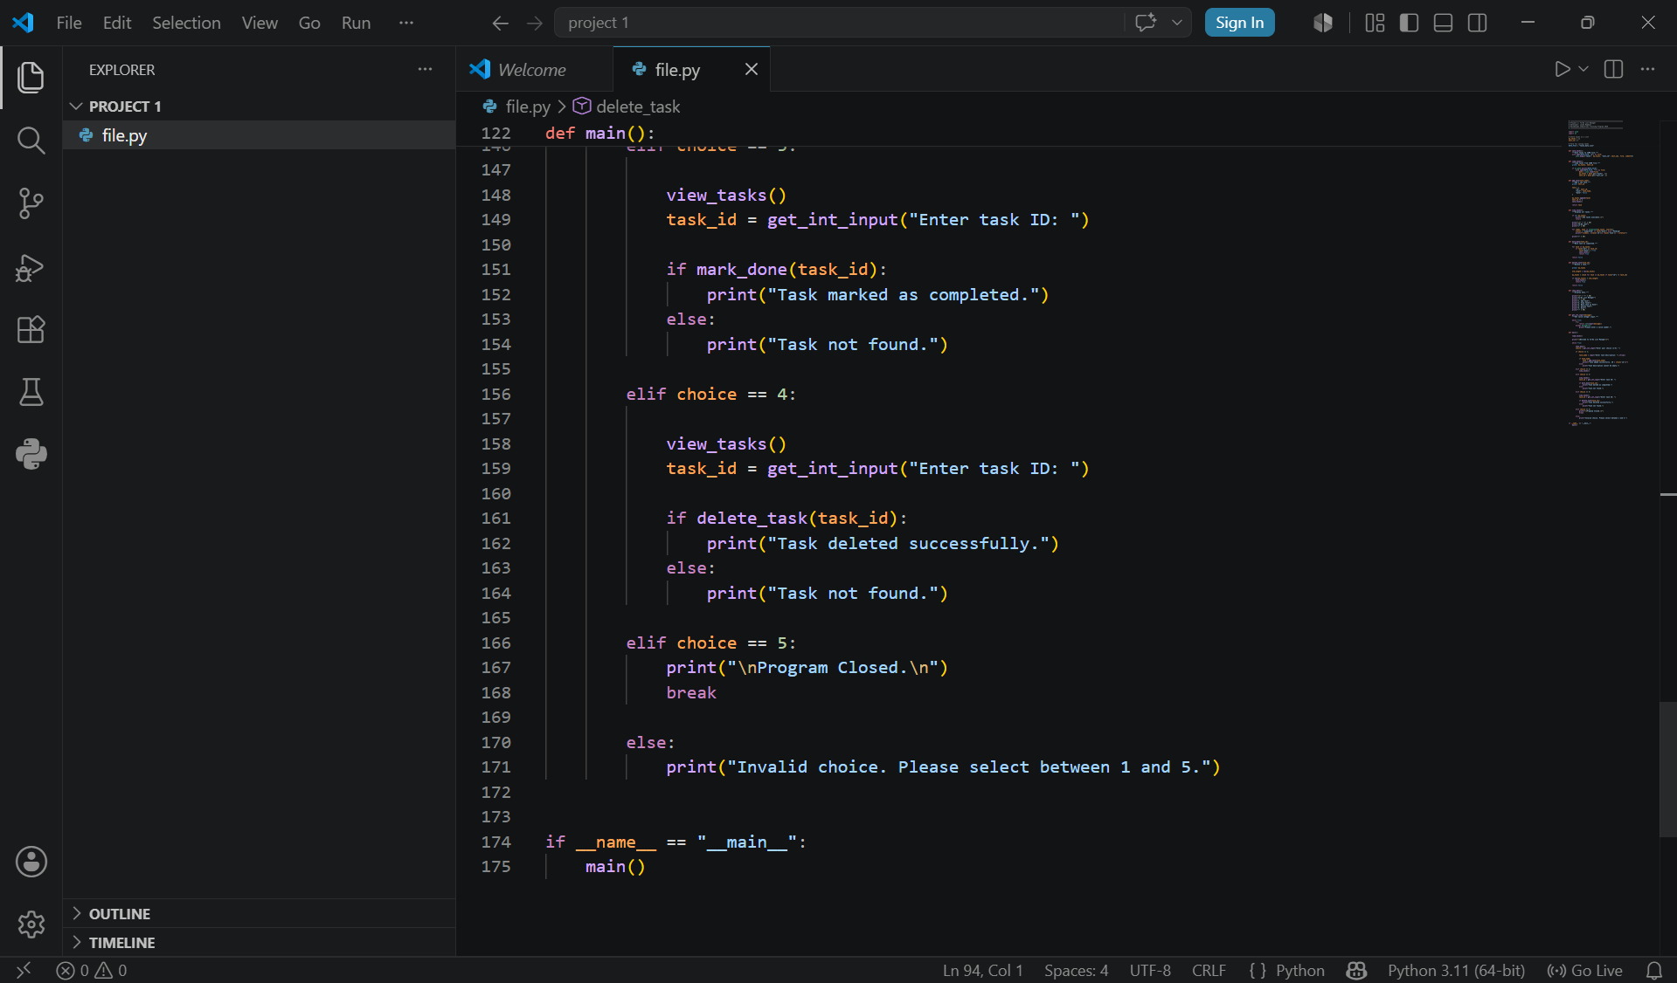

Slide 11
Choice Handlers — Model Responsibilities
Model functions encapsulate data operations and file I/O. Keep them pure and testable — each mutating action calls save_tasks() after updating in-memory state.
1
add_task(name)
2
view_tasks()
3
mark_done(id)
Append {'id': next_id, 'name': name, 'done': False} to my_tasks, then call save_tasks(). Validate name is non-empty.
Enumerate my_tasks and print each with index/ID and status. Keep formatting consistent for easy parsing in tests.
Find task by id, set task['done'] = True, then save_tasks(). Return a boolean indicating success.
4
delete_task(id)
5
EXIT
Rebuild list excluding matched id via list comprehension, then save_tasks(). Preserve or reassign stable IDs.
Gracefully break the main loop. Optionally save on exit to ensure final state is persisted.
DecodeLabs | Project 1

Slide 12
Data Structures & Core Concepts
Python Lists
Task Data Model
my_tasks = [] serves as the in-memory table — fast append and iteration.
# Globals
my_tasks = []
next_id = 1
enumerate()
# Task structure
Iterate with index + value — cleaner than range(len()) for displaying tasks.
task = {
"id": next_id,
"task": name,
Dictionaries as Rows
"done": False
}
Each task = {'id', 'task', 'done'} models a DB row — lightweight and explicit.
# Persist
json.dump(my_tasks, f,
indent=2)
JSON Persistence
json.dump() and json.load() persist my_tasks — avoids volatile-memory loss.
DecodeLabs | Project 1

Slide 13
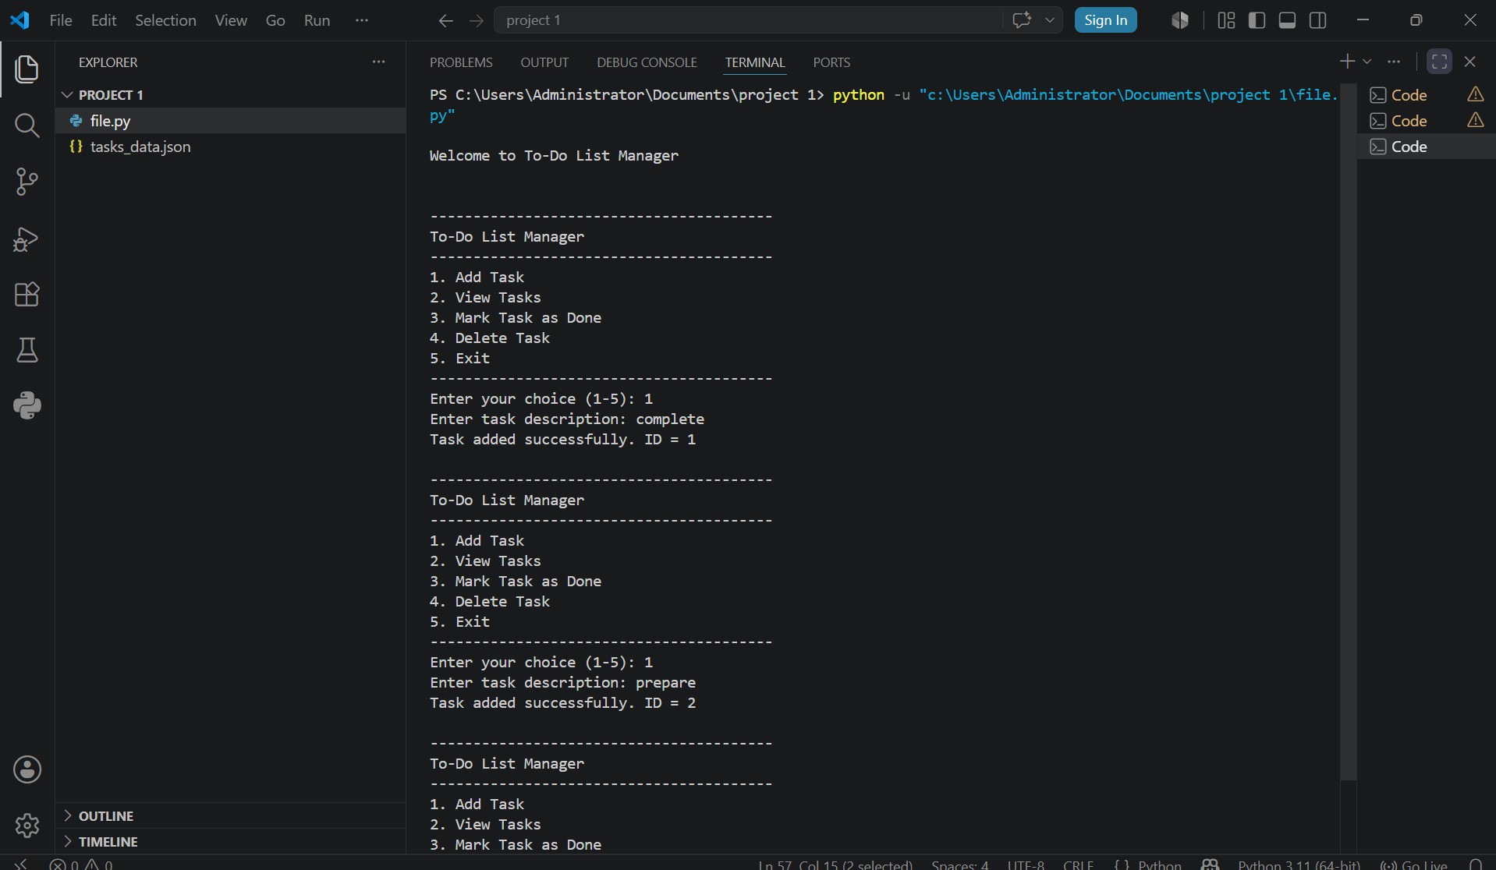

Slide 14
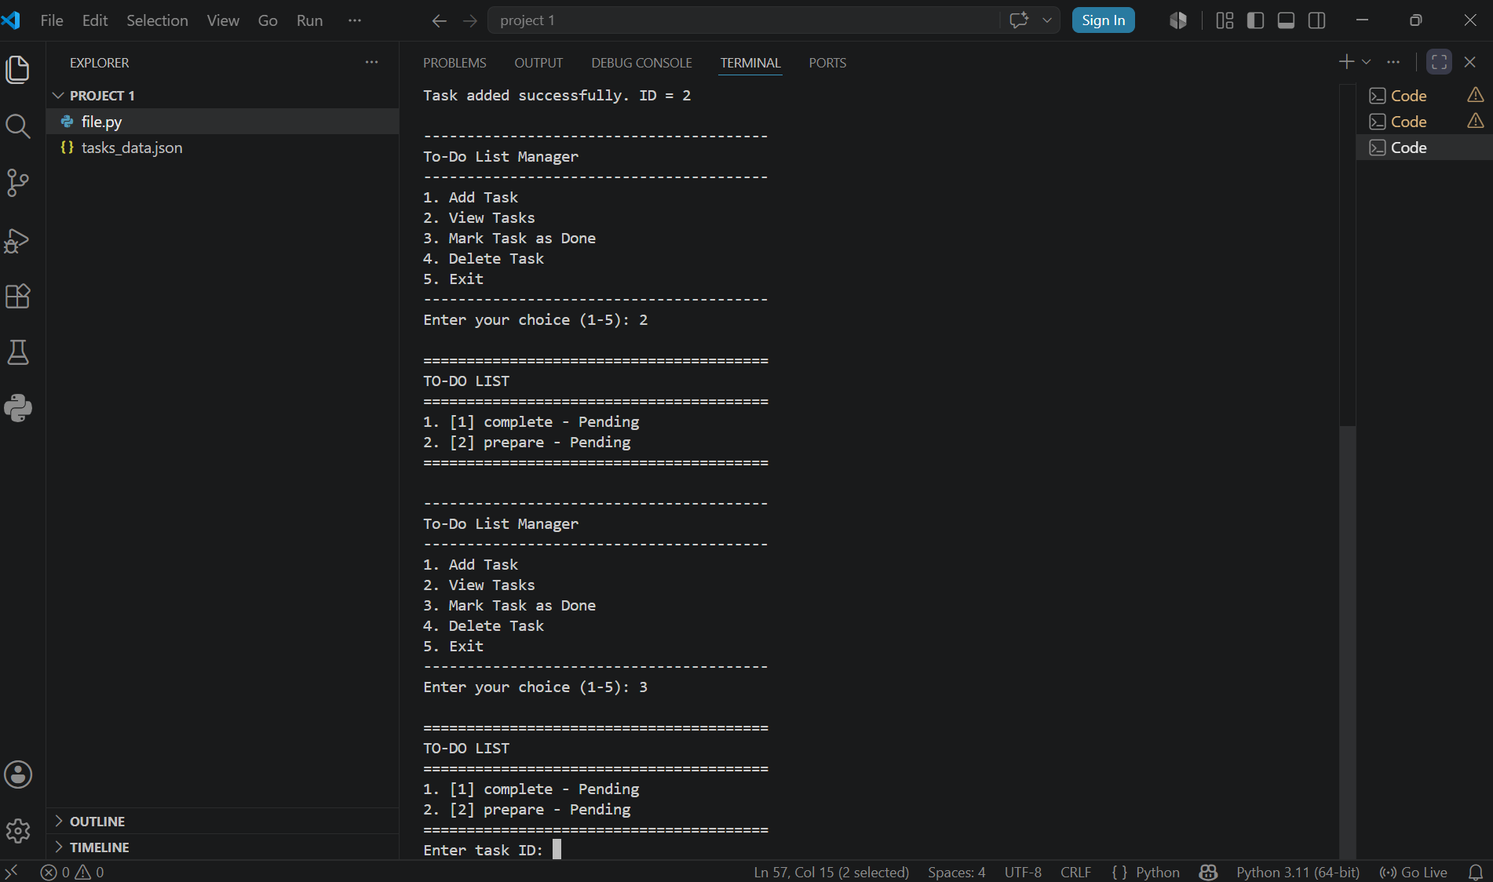

Slide 15
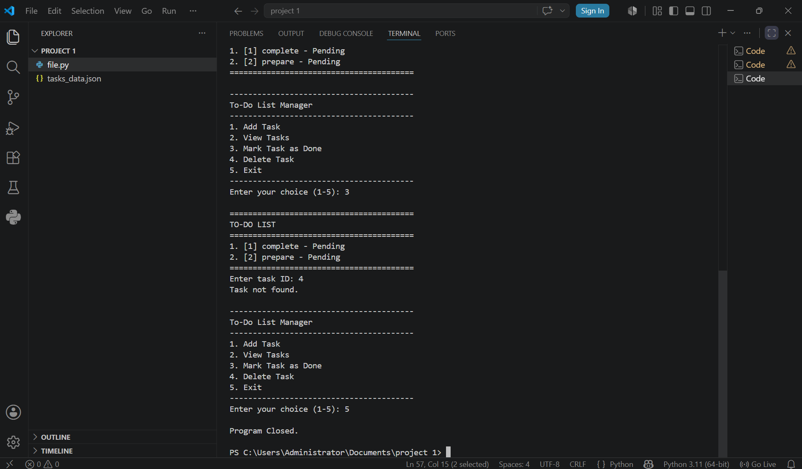

Slide 16






Best Practices & Reliability Tips
API Boundary
Persistence Safety
Testing Strategy
Expose Model functions with clear inputs/outputs — controllers call them without side effects like direct prints or input() calls.
Use atomic file writes (write to temp file then rename) or context-managed json.dump() to reduce corruption risk.
Mock filesystem access in tests, inject an in-memory list for unit tests, verify save_tasks() calls with a temporary file.
Readable Output
DELETE Pattern
MVC Separation
Include human index and persistent id: "1. [ ] [3] Buy groceries" — helps debugging, testing, and user interaction.
my_tasks = [t for t in my_tasks if t['id'] != task_id] — readable, expressive, mirrors SQL DELETE WHERE.
Model (add_task, mark_done, save_tasks) is separated from View/Controller — easy unit testing and future GUI migration.
DecodeLabs | Project 1

Slide 17
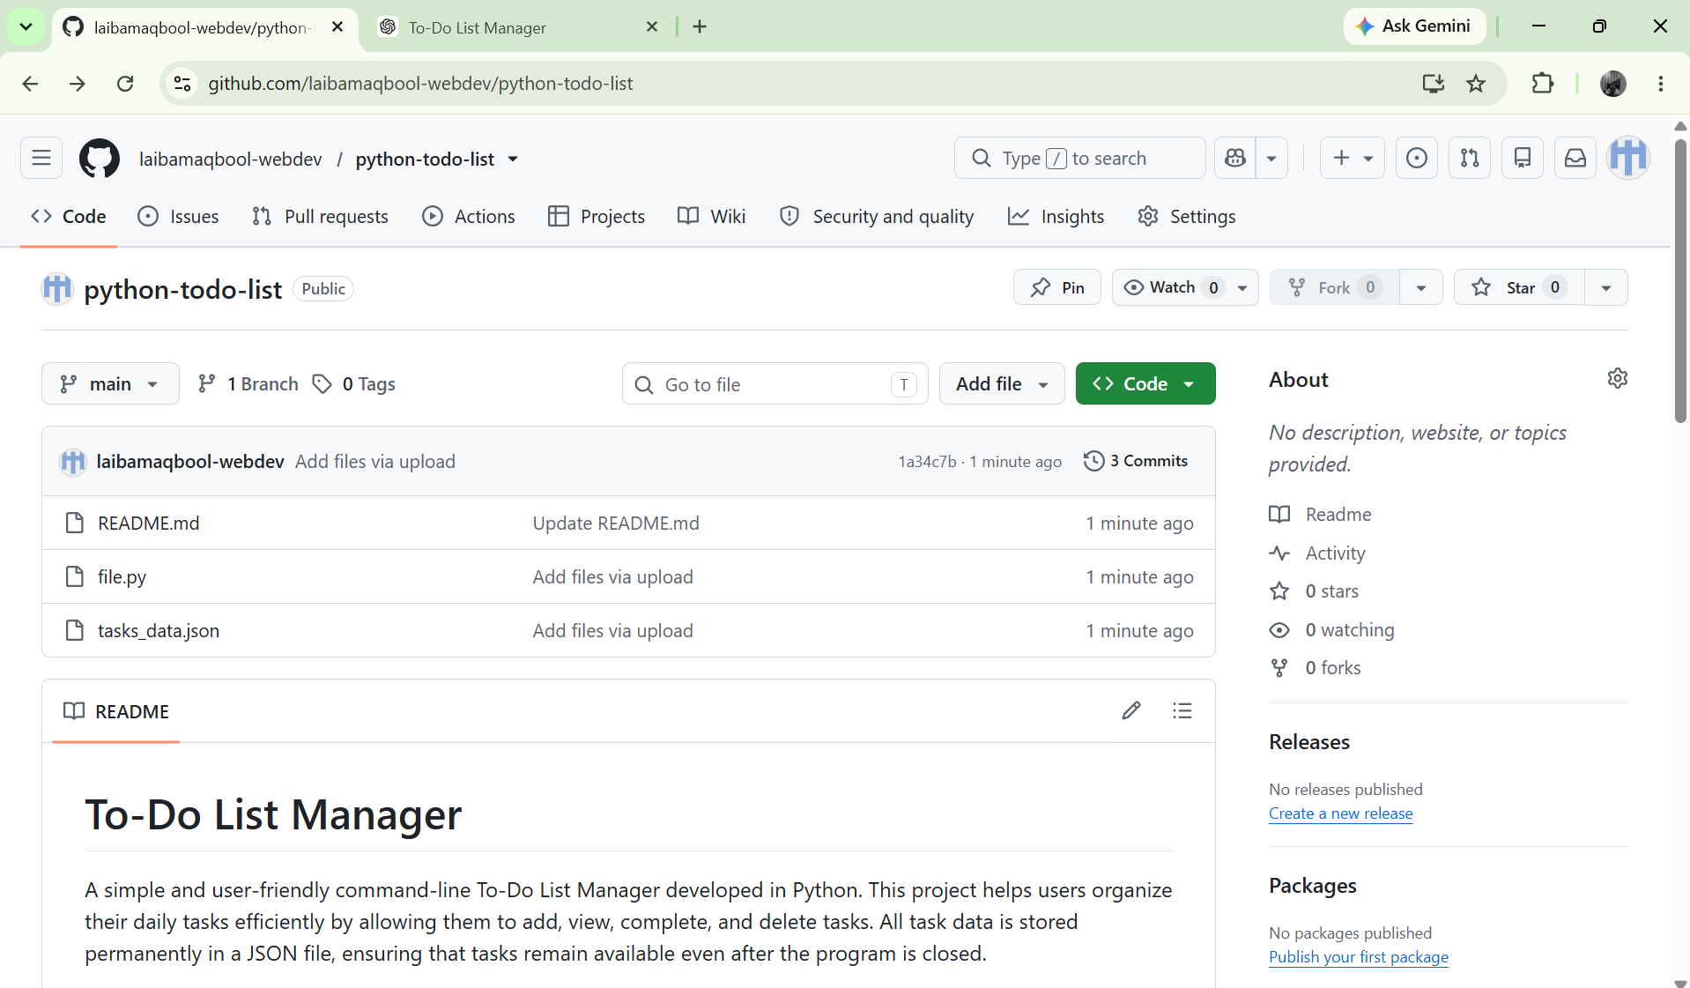

Slide 18
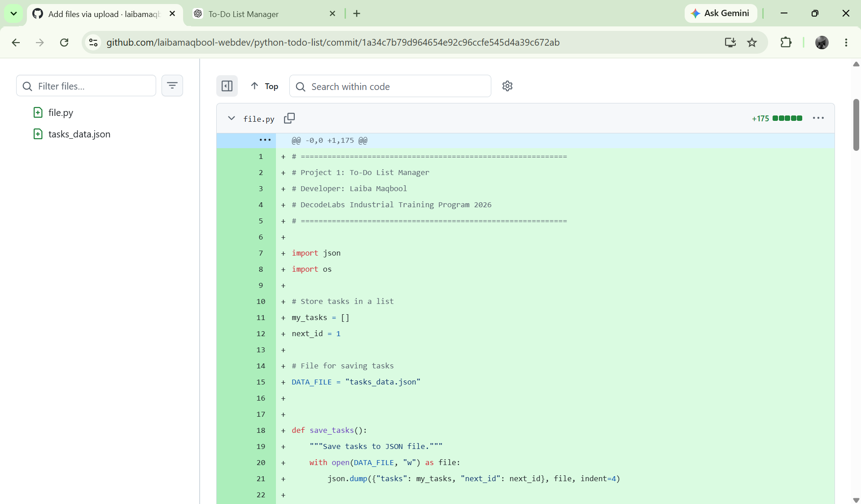

Slide 19
Project Complete
To-Do List
Manager
A complete CLI application demonstrating Python fundamentals — lists, dicts, file I/O, and JSON persistence.
✔ CLI Application
✔ JSON Persistence
✔ CRUD Operations
✔ MVC Architecture
Laiba Maqbool — Python Developer (Intern)
DecodeLabs | Project 1

